Slide 1
Sequence Diagram
UML

Slide 2
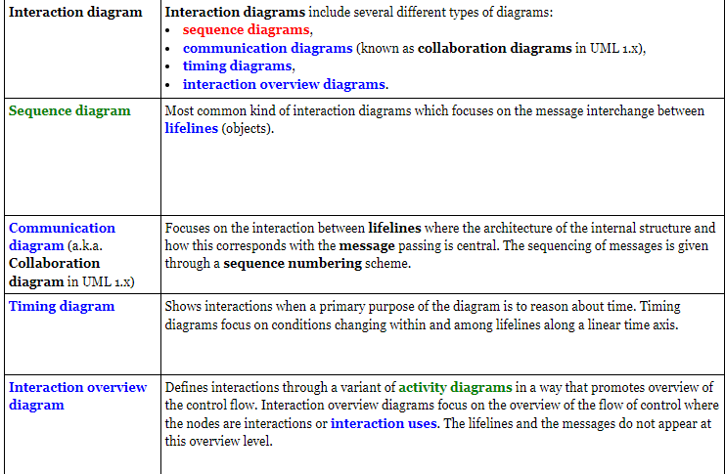

Slide 3
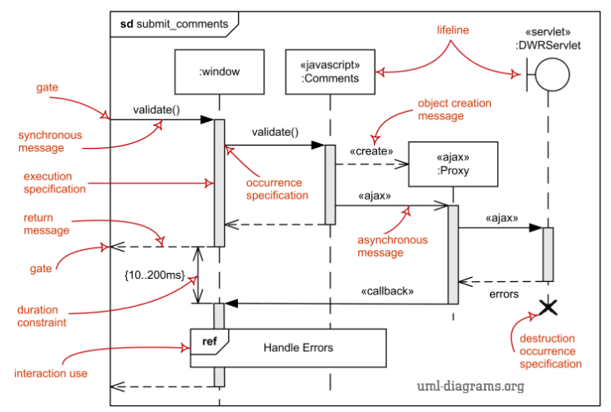
Sequence diagram
Focuses on the message interchange between a number of lifelines
The following nodes and edges are typically drawn in a UML sequence diagram
lifeline,
execution specification,
message,
combined fragment,
interaction use,
state invariant,
continuation,
destruction occurrence.

Slide 4
UML Interaction
An interaction is a specialization of both behavior and of interaction fragment which represents a unit of behavior that focuses on the observable exchange of information between connectable elements.
Interactions focus on the passing of information with messages between the connectable elements of the classifier.
The semantics of an interaction is defined in UML as a pair of sets of traces - valid traces and invalid traces
A trace is a sequence of event occurrences denoted <e1, e2, ... , en>, each of which is described by an occurrence specification.
Each occurrence in interactions is normally interpreted to take zero time. Duration is always assumed to be measured between occurrences.
As a behavior an interaction is specializable and redefineable.
The notation for an interaction is a solid-outline rectangle frame. The pentagon in the upper left corner of the rectangle contains the keyword sd followed by the interaction name and parameters.
The notation within the rectangular frame is one of the form of: sequence diagram, communication diagram, timing diagram, or interaction overview diagram.

Slide 5
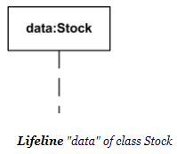
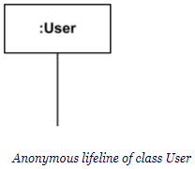
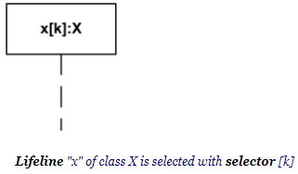
Lifeline
A lifeline is a named element which depicts an individual participant in a sequence diagram. So basically each instance in a sequence diagram is represented by a lifeline.
Lifeline elements are located at the top in a sequence diagram.
The standard in UML for naming a lifeline follows the following format – Instance Name : Class Name
If the referenced connectable element is multivalued, then the lifeline may have an expression (selector) that specifies which particular part is represented by this lifeline.

Slide 6
UML Message
Message is a named element that defines one specific kind of communication between lifelines of an interaction
A message is shown as a line from the sender message end to the receiver message end.
The line must be such that every line fragment is either horizontal or downwards when traversed from send event to receive event
There are two major types of messages in Sequence Diagram:
Message by Action Type - a message reflect either an operation call or start of an execution or sending/receiving of a single
Synchronous call
Asynchronous call/ signal
create
delete
reply
Message by Presence of Events - a message depends upon whether messages send event and receive events are present
complete message
lost message
found message
unknown message (default)

Slide 7
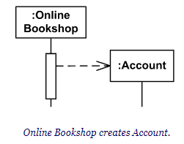
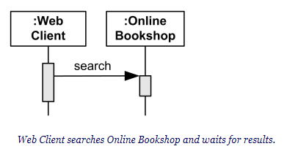
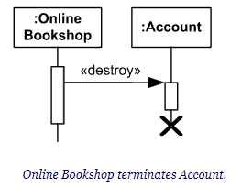
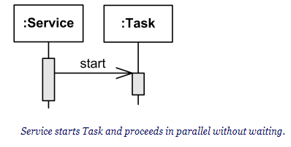
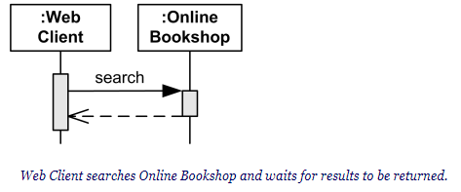
Message by Action Type
Synchronous call typically represents operation call - send message and suspend execution while waiting for response.
Create message is sent to a lifeline to create itself.
Delete message (called stop in previous versions of UML) is sent to terminate another lifeline.
Asynchronous call - send message and proceed immediately without waiting for return value.
Reply message to an operation call is shown as a dashed line with open arrow head (looks similar to creation message).

Slide 8
Message by presence of event
Complete Message
Semantic: <SentEvent, ReceiveEvent>
both sent and received events are present
Lost message (just send event)
Found message (just receive event)
Unknown message (default) - both absent (should not appear in SD)

Slide 9
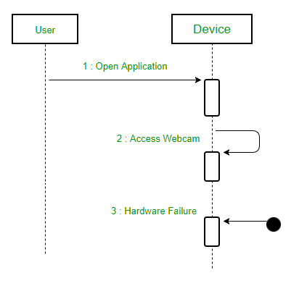
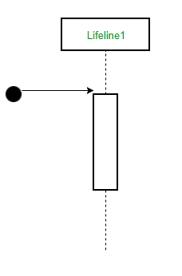
Message by presence of event
Found Message – A Found message is used to represent a scenario where an unknown source sends the message. It is represented using an arrow directed towards a lifeline from an end point. For example: Consider the scenario of a hardware failure.
It can be due to multiple reasons and we are not certain as to what caused the hardware failure.
Reference: https://www.geeksforgeeks.org/unified-modeling-language-uml-sequence-diagrams/

Slide 10
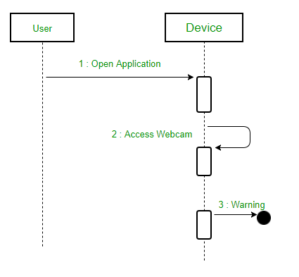
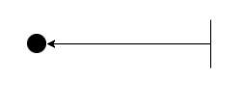
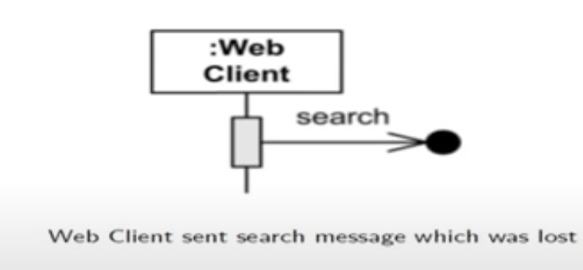
Lost Message – A Lost message is used to represent a scenario where the recipient is not known to the system. It is represented using an arrow directed towards an end point from a lifeline. For example: Consider a scenario where a warning is generated.
Reference: https://www.geeksforgeeks.org/unified-modeling-language-uml-sequence-diagrams/

Slide 11
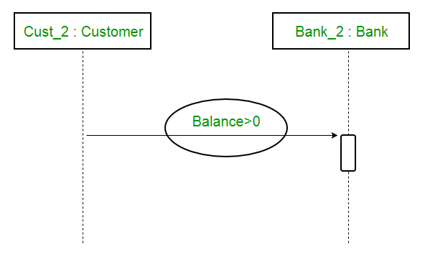
Guards – To model conditions we use guards in UML. They are used when we need to restrict the flow of messages on the pretext of a condition being met. Guards play an important role in letting software developers know the constraints attached to a system or a particular process. For example: In order to be able to withdraw cash, having a balance greater than zero is a condition that must be met as shown below.
Reference: https://www.geeksforgeeks.org/unified-modeling-language-uml-sequence-diagrams/

Slide 12
Gate
A gate is a message end, connection point for relating a message outside of an interaction fragment with a message inside the interaction fragment.
The purpose of gates and messages between gates is to specify the concrete sender and receiver for every message. Gates play different roles:
formal gates - on interactions
actual gates - on interaction uses
expression gates - on combined fragment
The gates are named implicitly or explicitly. Implicit gate name is constructed by concatenating the direction of the message ("in" or "out") and the message name, e.g. in_search, out_read.

Slide 13
Interaction Fragment
Interaction fragment is a named element representing the most general interaction unit.
Examples of interaction fragments are:
Occurrence
execution
state invariant
combined fragment
interaction use

Slide 14
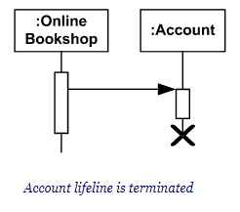
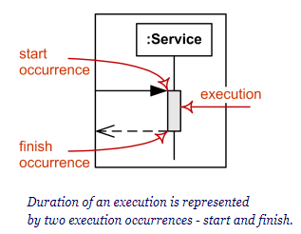
Occurrence
Occurrence or occurrence specification, i.e. "event description" → represents a moment in time (event) at the beginning or end of a message or at the beginning or end of an execution.
Each occurrence specification appears on exactly one lifeline.
Occurrence specification has no notation and is just a point at the beginning or end of a message or at the beginning or end of an execution specification.
Examples of occurrences are:
message occurrence - represents sending and receiving of signals or invoking or receiving of operation calls.
execution occurrence - represents moments in time at which actions or behaviors start or finish.
Destruction Occurrence

Slide 15
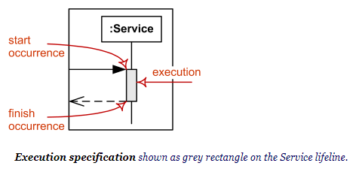
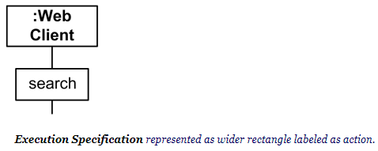
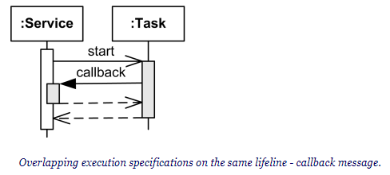
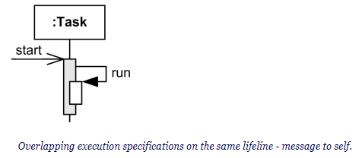
Execution
Represents a period in the participant's lifetime when it is
executing a unit of behavior or action within the lifeline,
sending a signal to another participant,
waiting for a reply message from another participant.
The duration of an execution is represented by two execution occurrences - the start occurrence and the finish occurrence.
Execution is represented as a thin grey or white rectangle on the lifeline.

Slide 16
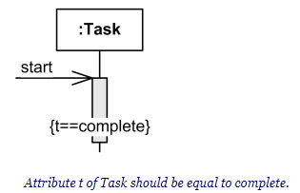
State invariant
Represents a runtime constraint on the participants of the interaction
The constraint is evaluated immediately prior to the execution of the next occurrence specification
State invariant is usually shown as a constraint in curly braces on the lifeline.

Slide 17
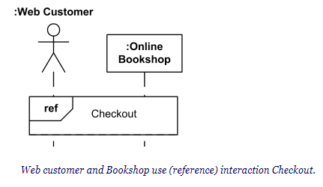
Interaction use
An interaction fragment which allows to use (or call) another interaction.
Referenced interaction has formal gates. Interaction use provides a set of actual gates that must match the formal gates of the interaction.
Interaction use works as:
copy the contents of the referred interaction to where this interaction needs to be used,
substitute formal parameters with arguments,
connect the formal gates with the actual ones.

Slide 18
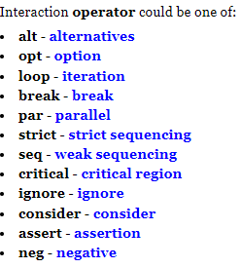
Combined Fragment
Interaction constraint
Defines a combination (expression) of interaction fragments.
A combined fragment is defined by an interaction operator and corresponding interaction operands.
Through the use of combined fragments the user will be able to describe a number of traces in a compact and concise manner.
Combined fragment may have interaction constraints also called guards
An interaction constraint is a constraint used in interactions - a Boolean expression that guards an operand in a combined fragment.
An interaction constraint is shown in square brackets covering the lifeline where the first event occurrence will occur
UML 2.4 often refers to interaction constraint as a guard.

Slide 19
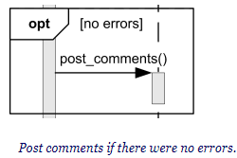
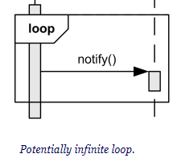
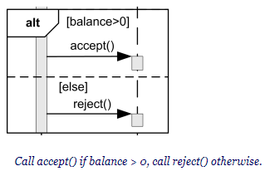
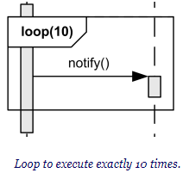
Alternatives
Option
Loop
The combined fragment represents a choice of behavior where either the (sole) operand happens or nothing happens.
Loop could be controlled by either or both iteration bounds and a guard.
If loop has no bounds specified, it means potentially infinite loop
The interaction operator alt means that the combined fragment represents a choice or alternatives of behavior.
At most one of the operands will be chosen.

Slide 20
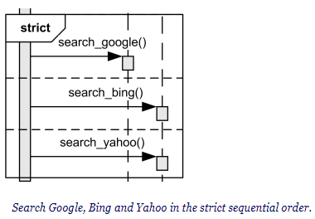
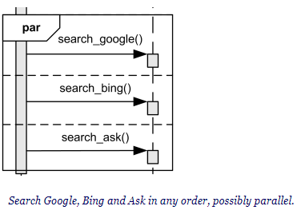
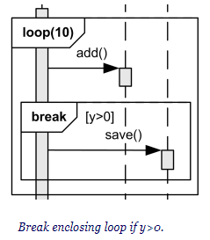
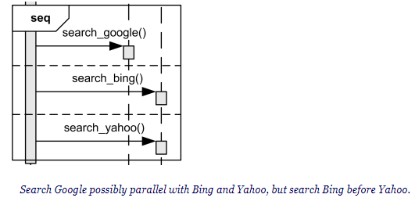
Break
Parallel
Strict Sequencing
A break operator with a guard is chosen when the guard is true. In this case the rest of the directly enclosing interaction fragment is ignored.
When the guard of the break operand is false, the break operand is ignored and the rest of the enclosing interaction fragment proceeds.
The interaction operator strict requires a strict sequencing (order) of the operands on the first level within the combined fragment.
Defines potentially parallel execution of behaviors of the operands of the combined fragment.
Different operands can be interleaved in any way as long as the ordering imposed by each operand is preserved.
Weak sequencing is defined by the set of traces with these properties:
The ordering of occurrence specifications within each of the operands is maintained.
Occurrence specifications on different lifelines from different operands may come in any order.
Occurrence specifications on the same lifeline from different operands are ordered such that an occurrence specification of the first operand comes before that of the second operand.

Slide 21
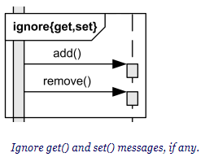
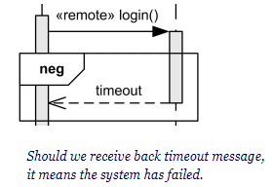
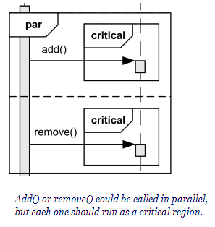
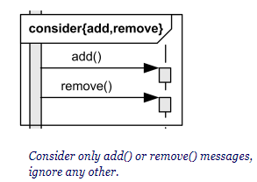
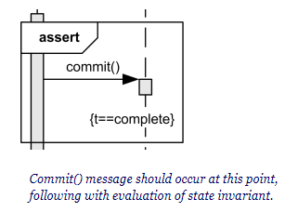
Ignore/Consider
Negative
Critical Region
Assert
Traces that are defined to be negative (invalid)
A critical region is a region with traces that cannot be interleaved by other occurrence specifications (on the lifelines covered by the region).
This means that the region is treated atomically by the enclosing fragment and can't be interleaved, e.g. by parallel operator.
sequences of the assert operand are the only valid continuations (must be satisfied by a correct design of the system)
All other continuations result in an invalid trace.

Slide 22
Reference
https://www.uml-diagrams.org/sequence-diagrams-reference.html

Slide 23
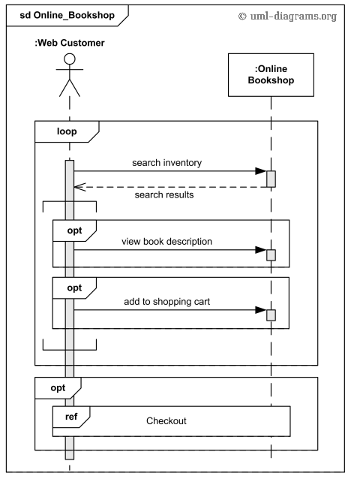
Sequence Diagrams Examples
An example of high level sequence diagram for online bookshop. Online customer can search book catalog, view description of a selected book, add book to shopping cart, do checkout.

Slide 24
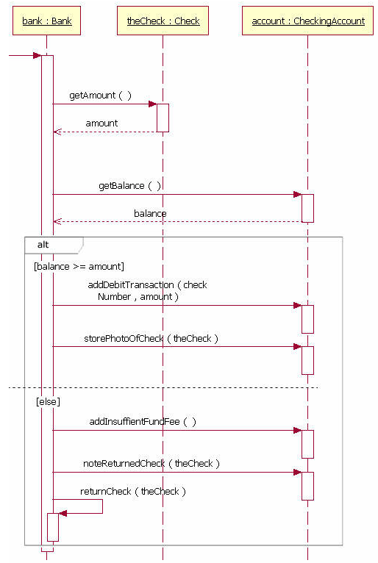
Sequence Diagrams Examples

Slide 25
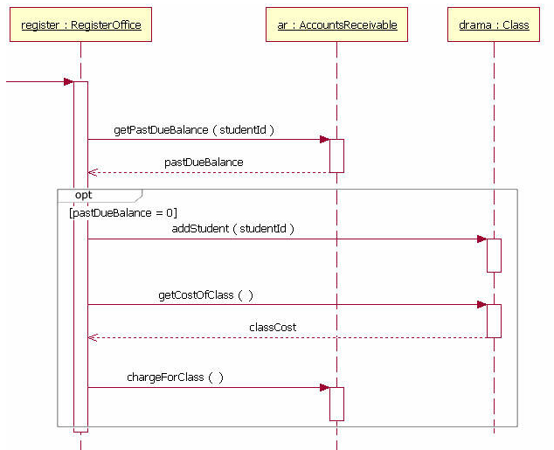
Sequence Diagrams Examples

Slide 26
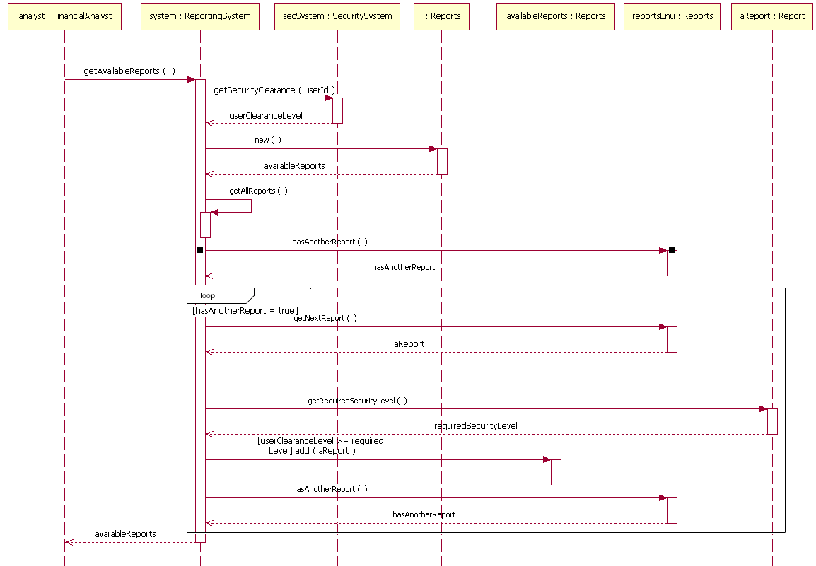

Slide 27
